Slide 1
Machine Translation

Slide 2
Statistical machine translation (SMT) is a machine translation paradigm where translations are generated on the basis of statistical models whose parameters are derived from the analysis of bilingual text corpora.
MT is a sequence to sequence task. So you have a sequence of words in one language as an input, and you want to produce a sequence of words in some other language as an output
Google Translate alone serves more than 500 million monthly users and translates about 140 billion words per day
Wikipedia has distinct pages for all types of machines translation.
Dictionary-based
Rule-based
Transfer-based
Example-based
Interlingual
Neural

Slide 3
Rule-based Machine translation
Rules are handwritten by language linguists to translate into the target language.
Rule-based systems have to contain huge numbers of rules since languages differ in structure
They're very expensive to create and maintain and require a lot of specialist knowledge
It can be very difficult to track through all the rules that are applied to produce a given translation

Slide 4
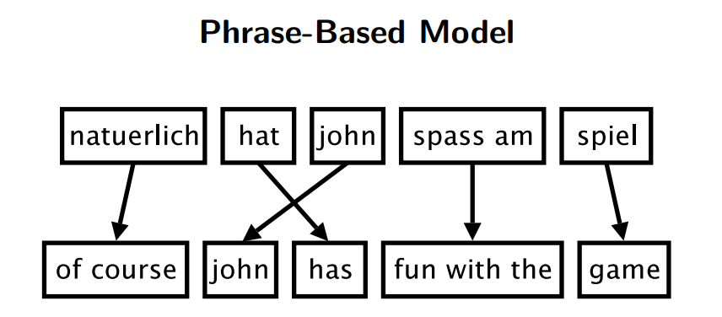
Phrase Based Translation Model
Foreign input is segmented in phrases
Each phrase is translated into English
Phrases are reordered
Gets some more complicated sentences you lose context if you don't remember the previous words beforehand you're going to get an inaccurate or poor translation

Slide 5
Neural Machine Translation(NMT)
NMT is a new approach to machine translation that uses a large neural network to enhance performance
The computer uses deep learning to build an artificial neural network to teach itself how to translate between languages
It uses these neural networks to translate entire sentences without breaking them down into smaller parts

Slide 6
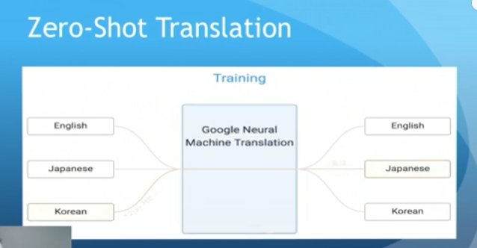
Zero – Shot Translation
This computer is being trained to translate from English to Korean Korean to English English to Japanese and then Japanese to English and without seeing any training data for Japanese to Korean it has taught itself how to translate from Japanese to Korean and Korean to Japanese

Slide 7
Evaluation of the data
Typically, there are many “perfect” translations of a given source sentence.
These translations may vary in word choice or in word order even when they use the same words.
How do we know that the translation is wrong just because it doesn't occur in your reference?
The language is so relative so every translator would do some different translations. It means that if your system produce something different it doesn't mean that it is wrong.
Consider two candidate translations of a Chinese source sentence:
Candidate 1: It is a guide to action which ensures that the military always obeys the commands of the party.
Candidate 2: It is to insure the troops forever hearing the activity guidebook that party direct.
For comparison, we provide three reference human translations of the same sentence below.
Reference 1: It is a guide to action that ensures that the military will forever heed Party commands.
Reference 2: It is the guiding principle which guarantees the military forces always being under the command of the Party.
Reference 3: It is the practical guide for the army always to heed the directions of the party.

Slide 8
We can rank Candidate 1 higher than Candidate 2 simply by comparing n-gram matches between each candidate translation and the reference translations.
We need to compare n-grams of the candidate with the n-grams of the reference translation and count the number of matches.
The more the matches, the better the candidate translation is.
There is baseline metric called BLEU score which measures whether your system output is somehow similar to the reference translation.
To compute this we calculate n-grams.
So you have some reference translation and you have the output of your system and you try to compare them

Slide 9
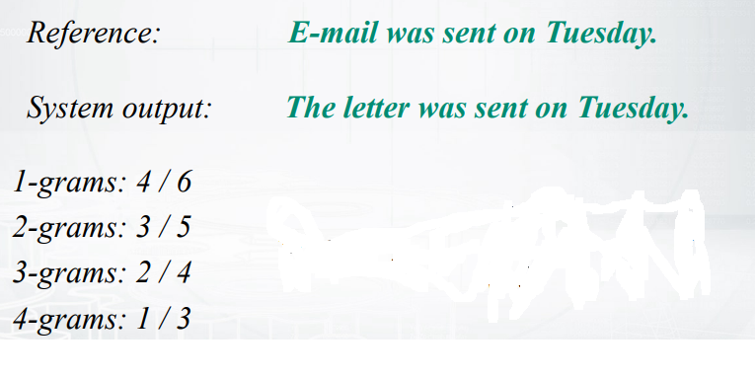

Slide 10
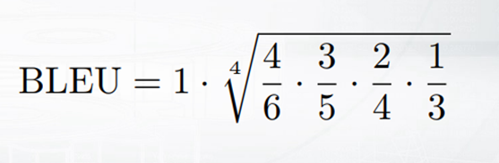
Let c be the length of the candidate translation and r be the reference corpus length.
We compute the brevity penalty BP,
BLEU (bilingual evaluation understudy) is an algorithm for evaluating the quality of text which has been machine-translated from one natural language to another. Quality is considered to be the correspondence between a machine's output and that of a human:
Using the geometric mean multiplied by a brevity penalty to prevent very short candidates from receiving too high a score
BP = 1 if c > r,
exp (1 − r/c ) if c ≤ r.

